Slide 1
NCA Sponsored Training
Day 2 – Morning Session (Lab)
Password Cracking
Presenter Name: Dr. Danish Vasan
City: Dhahran
16 February 2025
Notes:
Some of the material used in this presentation has been adapted and remixed from course materials from

Slide 2
Outline
Introduction to Password Cracking
Definition and motivations
Test password security
Prior data breach
HashCat
Introduction
Brute-force
Mask attacks
Dictionary attack
Hybrid attack

Slide 3


Password Cracking - Meaning
Password cracking refers to various measures used to discover computer passwords.
Why?
To recover a password for authorize access purpose (misplacing, missing)
To discover weak password in corporate networks/applications (Penetration Test)
To gain unauthorized access to an account without the owner’s awareness

Slide 4
Test Password Security
1) Visit the following URL:
https://lowe.github.io/tryzxcvbn/
This website estimates the strength of passwords you enter. Passwords never leave your browser – if you are so inclined, you can confirm as much by perusing the source code and/or by opening your browser developer tools and observing the (java)script that runs when you enter passwords.
2) Try out different passwords to see how strong they are

Slide 5
Check an Account for a Prior Data Breach
Check to see if one of your online accounts has already been breached:
https://haveibeenpwned.com
Type in one of your email accounts or usernames to see if it has already been compromised in a data breach.

Slide 6



Password Cracking - How to
DIFFERENT WAYS OF CRACKING THE PASSWORDS:
Using Keyloggers
Social Engineering (Phishing)
Guessing
OFFLINE attacks: Brute Force, Dictionary attack, Hybrid Attack, etc.

Slide 7
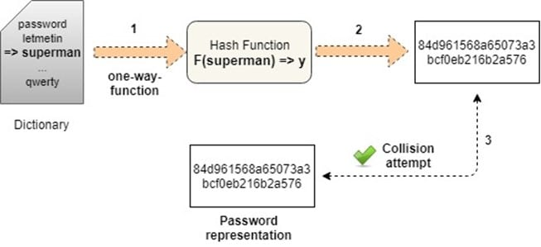
Offline Attacks - How to
Generate a “Candidate”
Apply the hash function
Verify the equality

Slide 8

Offline Attacks - Tools
CeWL is a Custom WordList Generator. It allows you to create word lists by spidering websites.
Hashcat is the world’s fastest and most advanced password recovery utility.
John the Ripper is a well-known free open-source password cracking tool. It offers password cracking for a variety of different password types (OS, common web apps, compressed archives, etc.)

Slide 9

Hashcat
It is an advanced password recovery tool
It is multiplatform (Windows, Linux, MacOS)
Support multiple types of attacks
It is used to reverse hash by generating password candidates

Slide 10
Hashcat – How Candidates are Generated
Brute-force: Tries all combinations from a given keyspace. It is the easiest of all the attacks.
Mask Attack: Try all combinations from a given keyspace just like in Brute-Force attack, but more specific.
Wordlist Attack: Read line by line from a textfile (aka “dictionary” or “wordlist”) and try each line as a password candidate.
Combinator Attack: Each word of a dictionary is appended to each word in a dictionary.
Hybrid Attack: is just a Combinator attack. One side is simply a dictionary, the other is the result of a Brute-Force attack.

Slide 11
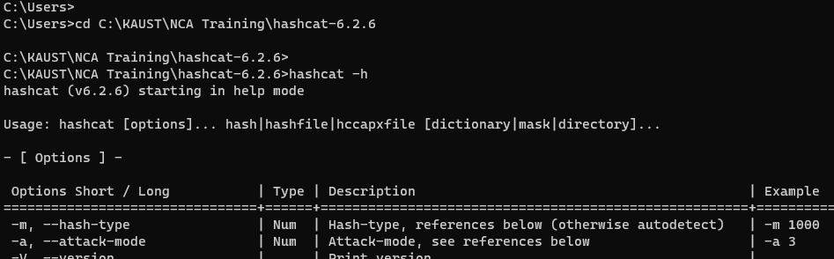
Hashcat – Getting Started
Open a command prompt
Go to the Hashcat folder
Execute the command “hashcat –h” to visualize the user guide
You can also find it online: https://hashcat.net/wiki/doku.php?id=hashcat

Slide 12
Hashcat – Usage
hashcat [options] input1 input 2
Tell hashcat what to do
Ex: -b -> benchmark
Give to hashcat other resources
Ex: a dictionary
The hash to be reversed, or the path of a file with one or more hashes

Slide 13
Hashcat – Basic Options
-m, --hash-type:
Hash-type (MD5, SHA1, etc.) followed by the Hash modes numbers
Example: -m 100
Most used Hash modes numbers:
0 -> MD5
100 -> SHA1
1400 -> SHA256
1700 -> SHA-512

Slide 14
Hashcat – Basic Options
-a, --attack-mode :
Attack mode (Brute force, Hybrid, etc.) followed by the attack modes numbers
Example: -a 3
Most used Attack modes numbers:
0 -> Straight
1 -> Combination
3 -> Brute-force
6 -> Hybrid Wordlist + Mask

Slide 15
Hashcat – Basic Options
Let's get hands dirty…

Slide 16
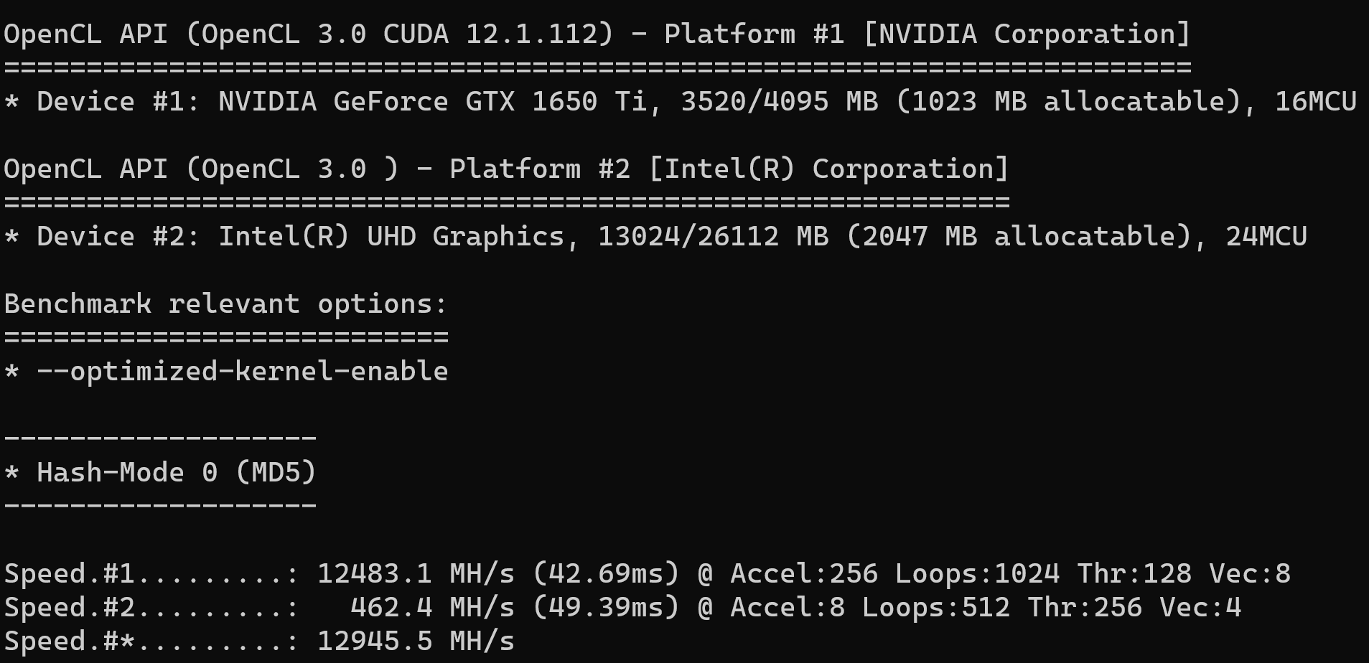
Test Password Security
1) Run the hashcat benchmark to check how fast is your system with MD5
hashcat – b –m 0
Your Devices
Results

Slide 17

Hashcat - Benchmark
Run the benchmark for the following algorithms:
SHA-1
SHA2-256
SHA3-256
NTLM

Slide 18
Hashcat – Brute-force
Reverse the following SHA2-256 hash:
8f8472a2f6ec348bfc7577a035c7f34a04c62f0c757b54687e1175236dcf393b
With the command:
hashcat -m 1400 -a 3

Slide 19
Hashcat – Mask attack
Advantage over Brute-Force:
reduce the password candidate keyspace to a more efficient one.
Example: We want to crack the password: Julia1984
Keyspace:
upper-case letters, lower-case letters and digits
The Password length is 9 = 62^9 (13.537.086.546.263.552) combinations.
Hash rate = 100MH/s = more than 4 years to complete.
With Mask attack we can reduce the keyspace to 52*26*26*26*26*10*10*10*10 (237.627.520.000) combinations. With the same hashing rate of 100MH/s, this requires just 40 minutes to complete.

Slide 20
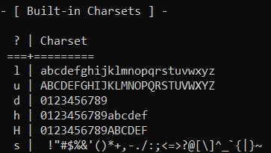
Hashcat – Mask attack – How to

Slide 21
Hashcat – Mask attack
Example: We want to crack the password: Julia1984
Hash:
028A44E44A6A2EDCE609CAABDEC635BE
Command:
hashcat -m 0 -a 3 028A44E44A6A2EDCE609CAABDEC635BE ?u?l?l?l?l?d?d?d?d

Slide 22
Hashcat – Mask attack – Custom Charset
The custom Charset commandline-parameters have four analogue shortcuts called -1, -2, -3 and -4. You can specify the chars directly on the command line or use a so-called hashcat charset file (plain text file with .hcchr extension which contains the chars/digits to be used on the 1st line of the file).
Example:
command: hashcat -a 3 -1 ?l?d ?1?1?1?1?1
keyspace: aaaaa – 99999

Slide 23
Hashcat – Mask attack
1) SHA1 (6 digits): 1052dade1b76d3c28feaaafa57ad6a09b202c9fc
2) SHA1 (digits and lowercase, length 6): 7782ded1754e94eea8fc6045edf1f024eb45dff3
3) SHA1 (use wordlist "/usr/share/wordlists/rockyou.txt"): aac9ecdcb18d37fc7357891a7a8a90b599cebc72
4) SHA256 (lowercase, length 8) 29b48c7194c25f057bf5b4b136266e676a1baf4510e798e2b29ccc68cfa4d01f
5) SHA256 (digits and lowercase, length 8) ba2bfb146095669e9ac997851982c45ad80bc0e0f0e05a8019ef2c3b2654c8e3

Slide 24
Hashcat – Hybrid Attack
The full Brute-Force keyspace is either appended or prepended to each of the words from the dictionary. That's why it's called “hybrid”.
Syntax: hashcat –m 0 –a “6 or 7” “hash” “dictionary path” “mask”
Example:
hashcat64.exe -m 0 -a 6 5D7845AC6EE7CFFFAFC5FE5F35CF666D password.lst ?d?d?d
hashcat64.exe -m 0 -a 7 5D7845AC6EE7CFFFAFC5FE5F35CF666D ?d?d?d password.lst

Slide 25
Hashcat – Hybrid Attack - Exercise
Your friend forgot his Windows password. He usually uses a combination of a name of one of his close family members combined with a four-digit year corresponding to a special event for him, terminated by a special character.
After recovering the hashed password (SHA2-256)
d274bee7f8fbcedb0d5ca26f106ec76a706c7b0435fd1cb4d27813cab21f6468
and knowing that his wife’s name is Francine, their sons are Mark, Julia, Bobby and Priscilla, are you able to help him recovering his password?
Notes:
hashcat -m 1400 -a 6 d274bee7f8fbcedb0d5ca26f106ec76a706c7b0435fd1cb4d27813cab21f6468 wordlist.txt ?d?d?d?d?s
wordlist.txt is a text file with the names inside, one per line
Priscilla1996!

Slide 26
Hashcat – Worldlist Attack
Download a Dictionary or create your own Wordlist
Use Hashcat with attack mode 0
Syntax: hashcat –m 0 –a 0 “hash” “dictionary path”
Example:
hashcat -m 0 -a 0 807FF71B3301262E222AD05E5B7C4325 password.lst

Slide 27

Do you have any questions?

